Slide 1
Autoencoder Classifier for Wafer resistance test map

Slide 2
Autoencoder
Autoencoder comprises of two parts of network, encoder and decoder.
Encoder extracts features from the image into “code”.
“Code” is actually compressed image or image consists only necessary features.
The “code” will then be decoded and forms the reconstructed image.

Slide 3
Encoder
In this context, the image is downsized using 3 convolution layers with strides (2,2).
This will downsize the image (42,42) -> (21,21) ->(11,11) ->(6,6)
At the encoded layer, we will have 40 neurons with shape (6,6).
This should capture all the necessary features in the images in the form of different compressed images.
If there are less neuron, it tends to be losing information/features.
Further compression of image may also lead to wrong classification of images since “saw” and “grind” defects tend to be at edge of wafer rather than at the center.

Slide 4
Decoder
The “code” which is the resultant of encoder, will now be decoded back to its original shape.
In this context, we will be following the same path:
(6,6)->(11,11)->(21,21)->(42,42)
Hence, upsampling layer is used. Size (2,2) is chosen so the image is twice in row and column. The padded row/column shares same value.
However, certain layer involves odd number of row and column.
Hence, lambda layer is used to remove last row and last column.
(6,6)->(12,12)->(11,11)->(22,22)->(21,21)->(42,42)

Slide 5
Decoder
Upsampling will pad the same value. Hence, convolution layer with stride (1,1) is needed in order to increase accuracy of the re-constructed image.

Slide 6
Training of autoencoder
The autoencoder is unsupervised learning. This is because both input and output is actually the same image.
The feature that it gathers is at the center “code” layer. The code will then used as input of classfier.
Hence, RMS is used to compile the model. This is because output is now an image.

Slide 7
Classifier
After training of autoencoder, the “code” can then be used to represent the extracted features.
However, autodecoder does not know how to map the extracted features to user classification.
Hence, dense layer can be connected to the output of “code” layer.
The final dense layer must have number of neuron fits the user defined number of classes. Each neuron represent likelihood to belong to each class.

Slide 8
Classifier
After training of autoencoder, the encoder is trained, so training of these layer must be disabled.
The dense layer will instead be trained by fitting input to input image and output to the user defined class.
Categorical crossentropy is used for fitting as it is now in categorical values.

Slide 9
Training Procedure
At first, autoencoder is trained using unlabeled data. This is because autodecoder is using unsupervised learning.
Then, the classifier will be trained using technician label data since the classifier will need information of final classification of known extracted features.
This will be two different set of data.

Slide 10
Prediction
Using 8:2 test split, both labelled and unlabelled data are split.
Train labelled data used for training the autoencoder then train label data used to train classifier.
The classifier will then make classification on unlabelled data.

Slide 11
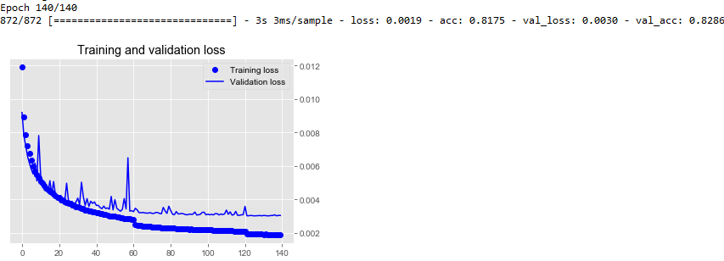
Result – Autodecoder Training
Autodecoder is lossy but it is still acceptable as it is used for classificvation purpose. 8286% accuracy.

Slide 12
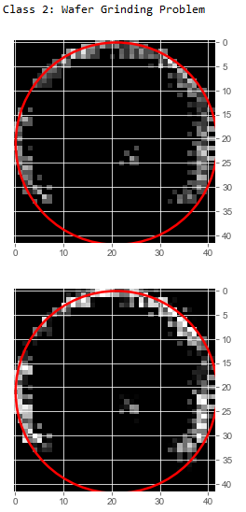
Result – Autodecoder Training
Reconstructed image sharpen the wafer map

Slide 13
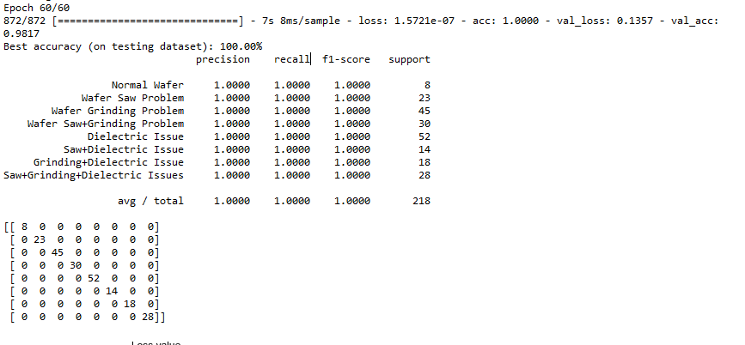
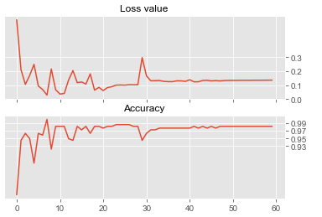
Result – Classifier Training
Classfication is achieving 98.17% at epoch 60.

Slide 14
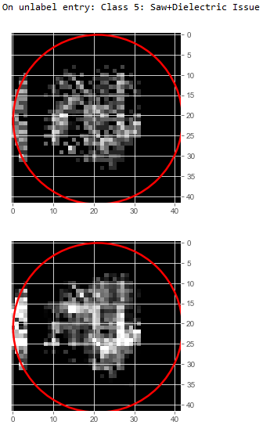
Result – Classifier Prediction
The correctly predicted class for the wafer map.

